Slide 1
Sentiment Analysis of Earnings Call Transcripts
-Team 5

Slide 2
Experiments
BOW model
Word embeddings (GLOVE)
RNN
Mean of the APIs (Azure, AWS, GCP, Watson)
Auto-ML model trained with the data from the APIs

Slide 3
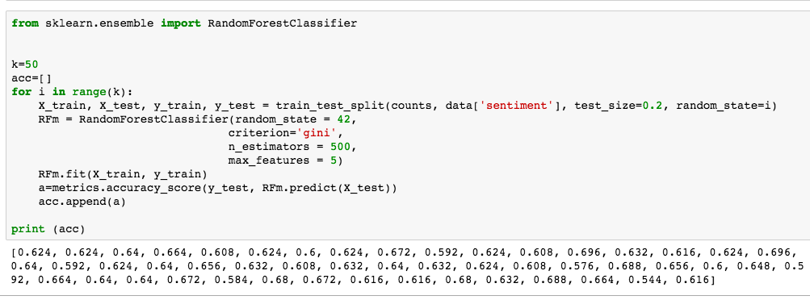
Bag Of Words Model
Accuracy on Financial Data ~ 64%, Accuracy on IMDB Data - ~90%

Slide 4
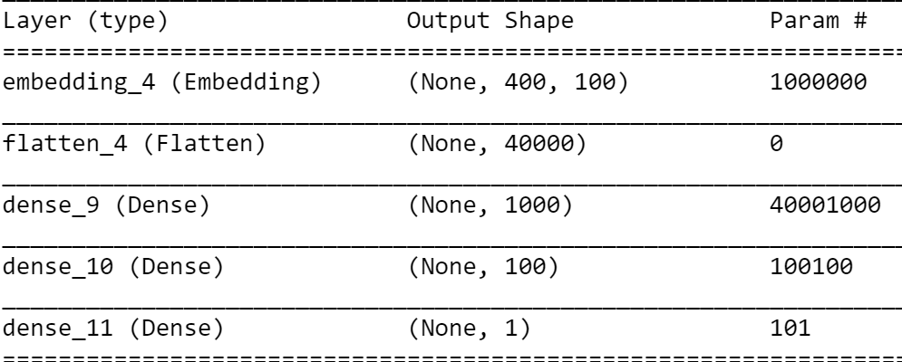
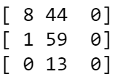
Word Embeddings (GLOVE)
Model Architecture And Confusion Matrix
N | + | -
As we can see in the confusion matrix, the model is biased towards POSITIVE sentiment as was the training data

Slide 5
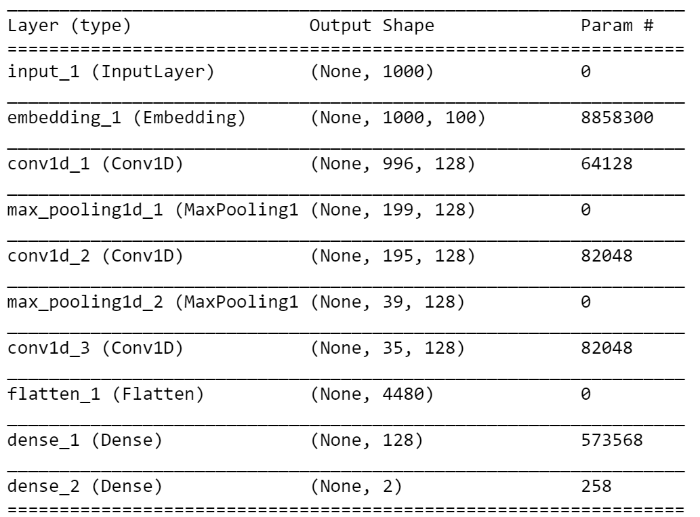

Word Embeddings (IMDB dataset)
Model Architecture and Confusion Matrix
- | +
loss: 0.2733 - acc: 0.8892 - val_loss: 0.3314 - val_acc: 0.8614
The model trained on IMDB dataset with 86% validation accuracy performs poorly on the Transcript Data

Slide 6
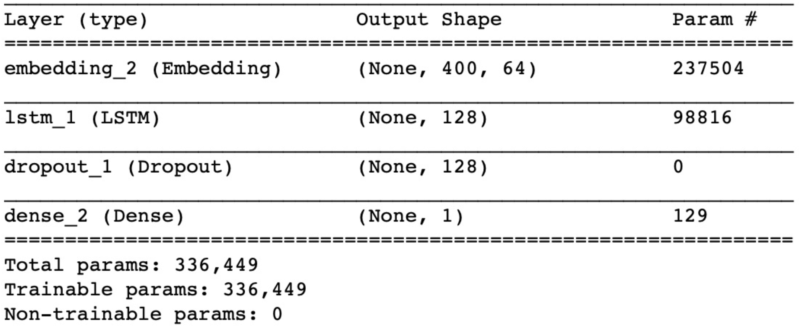
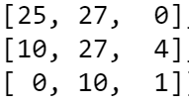
RNN model

Slide 7
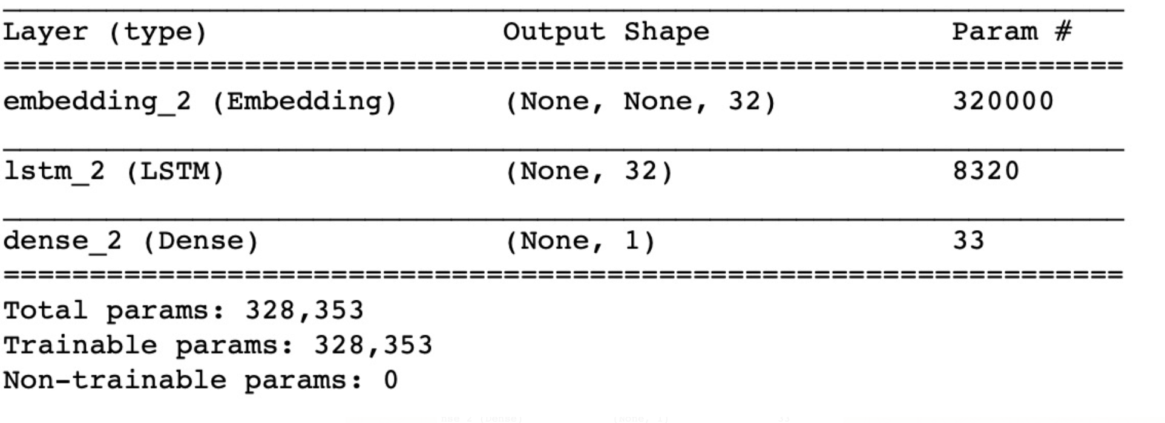
- | +

Slide 8
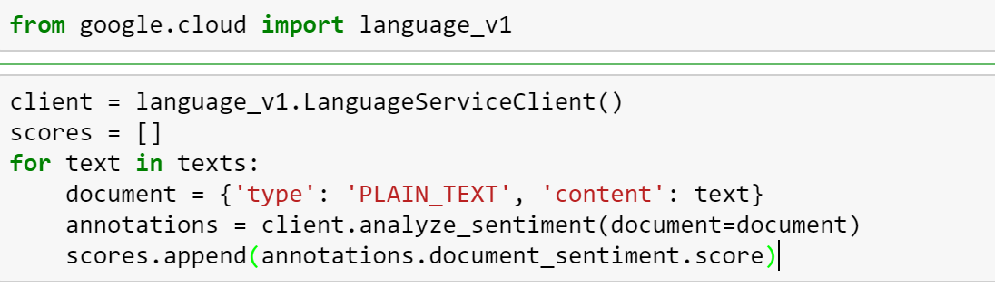
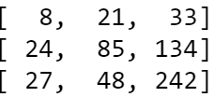
Mean of APIs Model
Google Cloud Language
Score ranges from -1 to 1 and is rounded of to the nearest integer
Confusion Matrix:

Slide 9
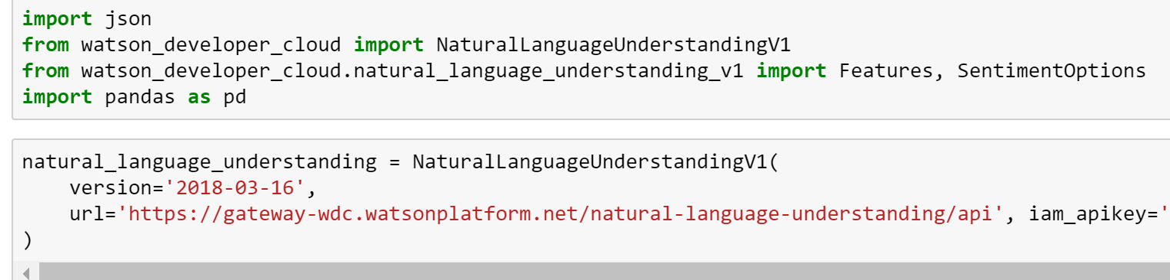
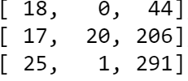
Watson Developer Cloud
Gives a numeric score as well as a label
Score is used for the mean and label for individual API evaluation
Confusion Matrix:

Slide 10
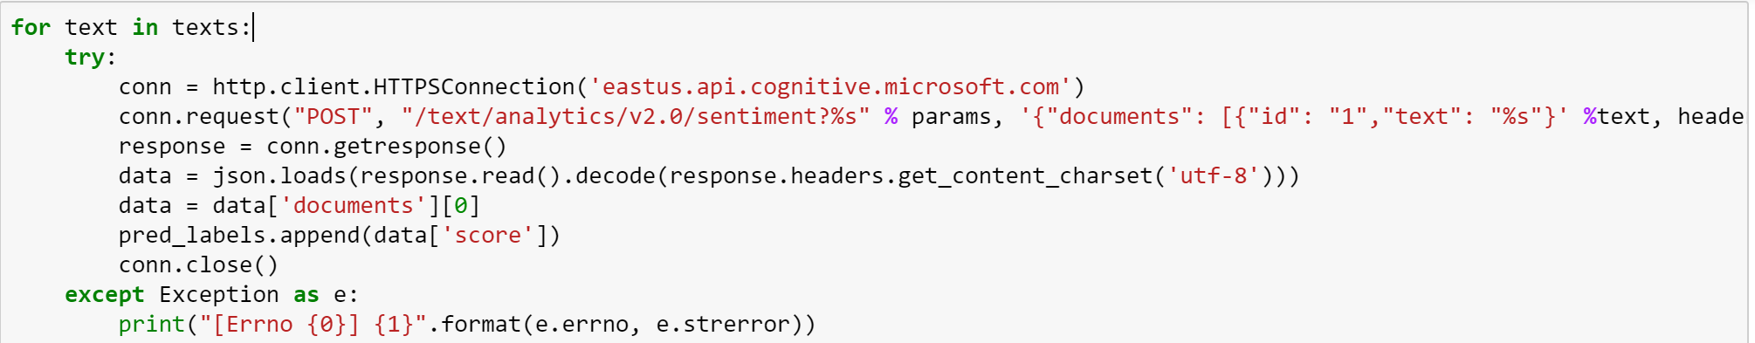
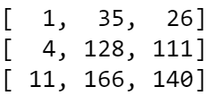
Azure Text Analytics
Gives a Score between 0 and 1; 0.5 being neutral
Confusion Matrix:

Slide 11
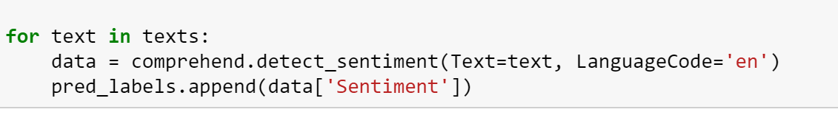
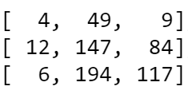
AWS Comprehend
Gives a numeric score as well as a label
Score is used for the mean and label for individual API evaluation
Confusion Matrix:

Slide 12
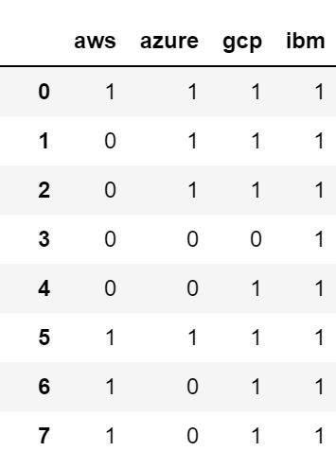
Auto-ML Model trained on API Labels
Training Data

Slide 13
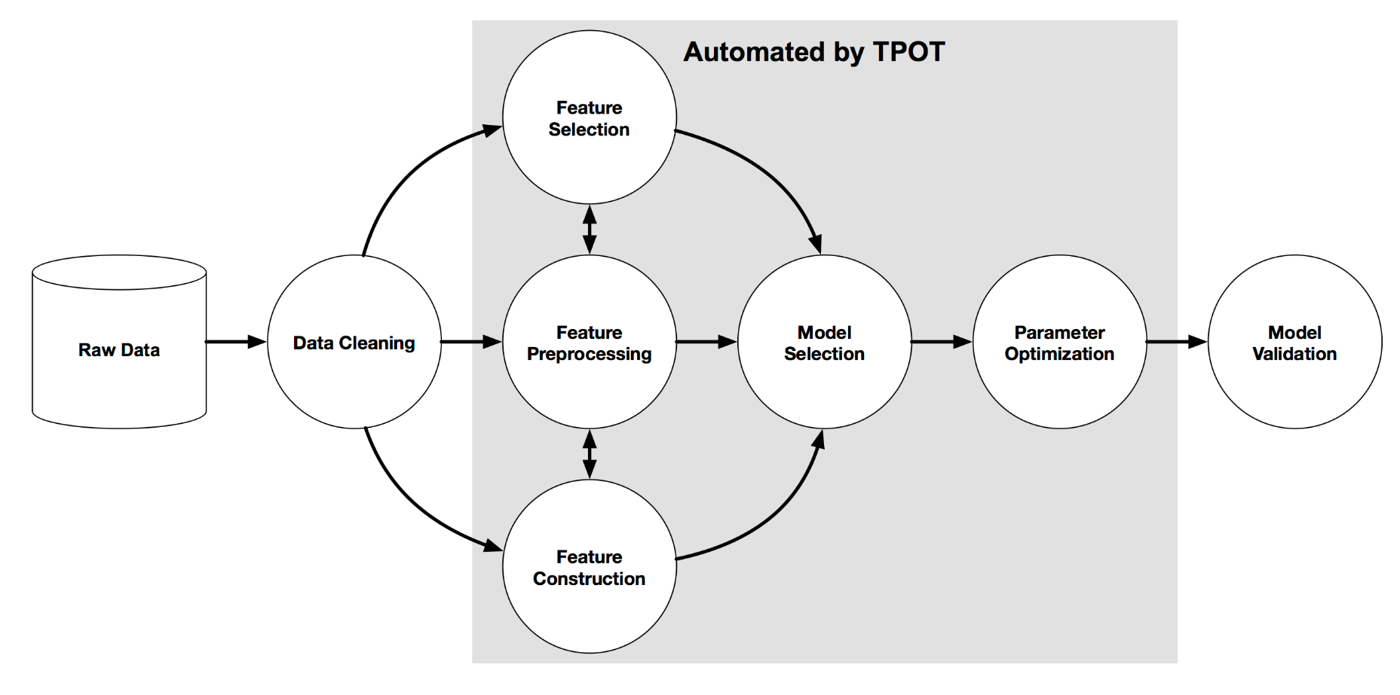

Slide 14
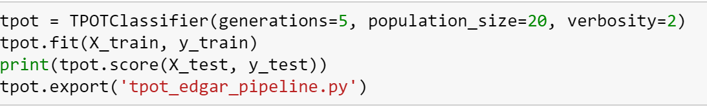
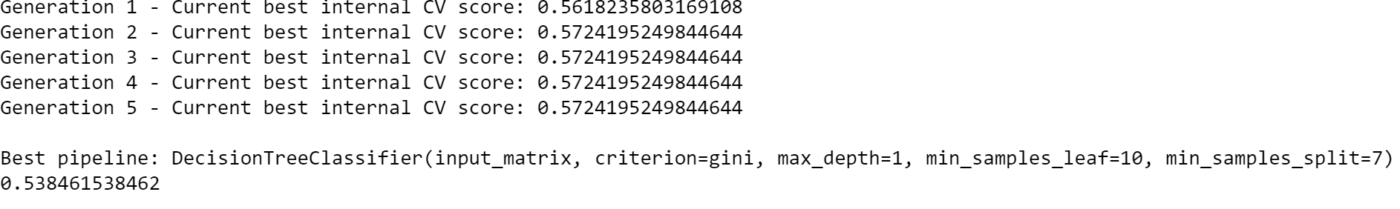
TPOT

Slide 15
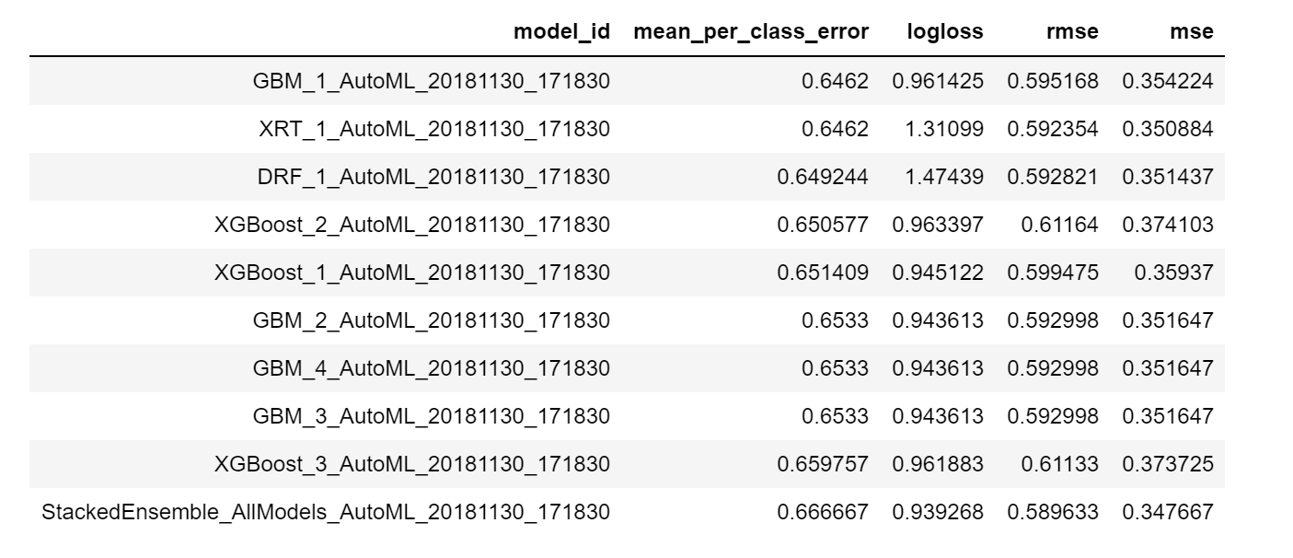
H2O

